Slide 1
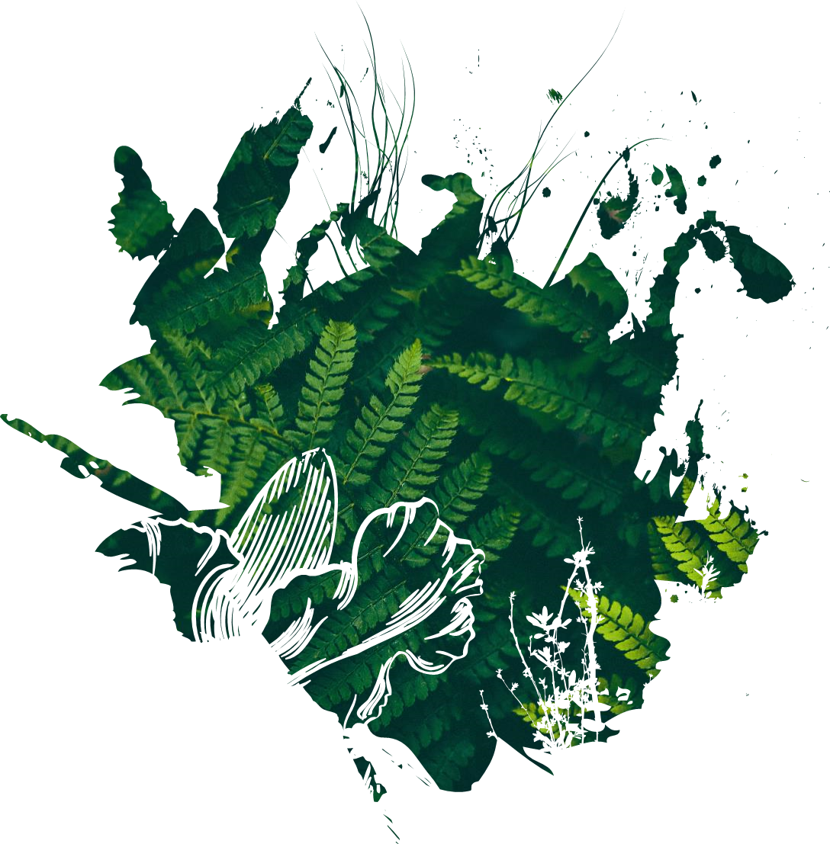
A snapshot into Animal Studies
Principles of Animal Handling

Slide 2
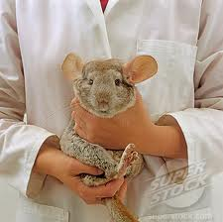
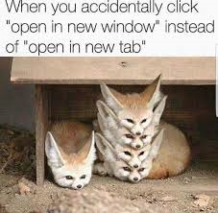
Human Animal Interaction
Learning Objectives
By the end of this presentation …
Identify occasions when animals may need to be handled and restrained.
Present initial ideas on methods to reduce stress when handling animals.
Research and discuss animal handling methods and equipment which can be utilised.

Slide 3
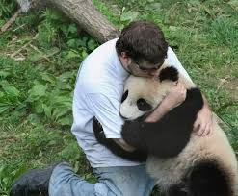
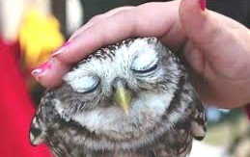
Animal Handling: Initial Considerations
Prior to handling an animal, you must decide the reason for the handling and what welfare issues may arise as a result of the interaction… you should never put an animal in a stressful situation if you can help it.
Health Check?
Movement?
Injury?
Vaccination?
Interaction?
The animal should always remain the priority.
When may this be difficult?

Slide 4
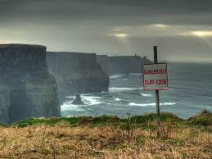
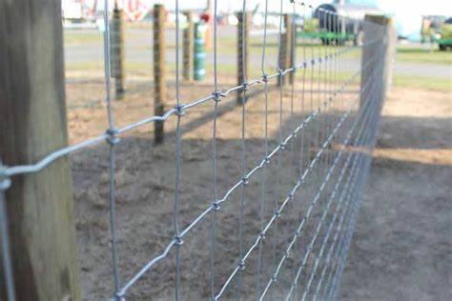
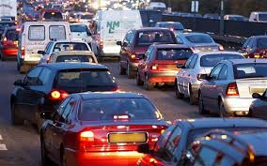
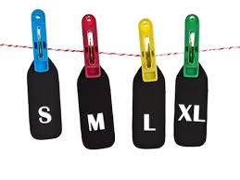
Animal Handling: Initial Considerations
What factors should be considered prior to the handling of any animal species, regardless of size or taxonomic group?
Definition: Taxonomic
Taxonomy is the practice of identifying different organisms, classifying them into categories, and naming them.
All organisms, both living and extinct, are classified into distinct groups with other similar organisms and given a scientific name.
Notes:
There are eight distinct taxonomic categories for animals.
These are: Domain, Kingdom, Phylum, Class, Order, Family, Genus, and Species.
With each step down in classification, organisms are split into more and more specific groups.
For example, all of the animals in the Kingdom Animalia are split into multiple phyla (plural of phylum). All of the animals in the phylum Chordata are split into multiple classes such as mammals, reptiles, and amphibians.

Slide 5
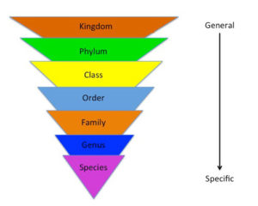
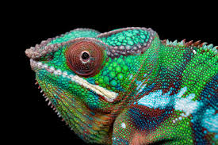
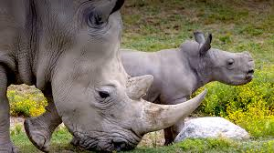
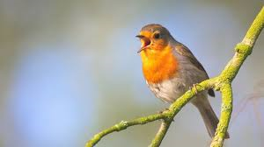
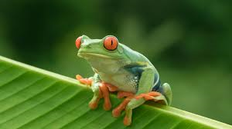
Animal Handling: Initial Considerations
Animals are very different and that is why they are categorised into various groups.
What about differences across taxonomic groups?
Task: Research the eight groups and
make a list of all of their differences.

Slide 6
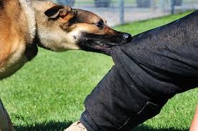
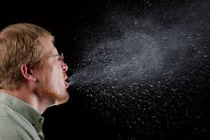
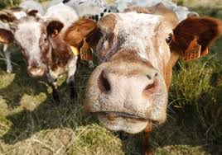
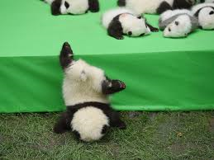
Animal Handling: Initial Considerations
Until an individual becomes particularly confident with their handling abilities it can be quite a stressful process for both the human(s) and animal involved, what are some of the main concerns from the perception of the person who is completing the handling…

Slide 7
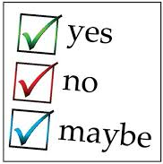
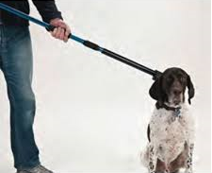
Animal Handling vs. Animal Restraining
What is the difference between restraining and handling an animal…
Restraint: “A measure of condition that keeps something under control”
Handle: “Manipulate with hands”
Task: Describe a scenario of both of these situations. Use key terms.
Restraint Equipment?
Clear difference?
Personal Protective Equipment?

Slide 8
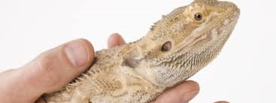
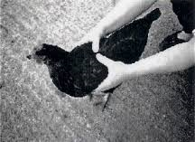
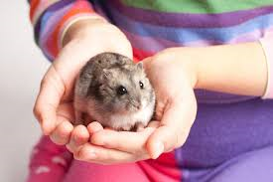
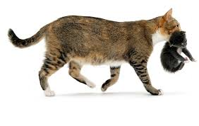
General Animal Handling Techniques
There are a number of methods of animal handling which can be used across different species…
The W Technique
The V Technique
Cupping Technique
Scruffing
Task: Draw a line diagram of how to position your
hands for the handling position.

Slide 9
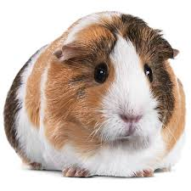
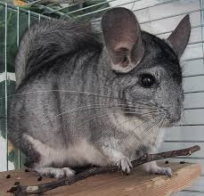
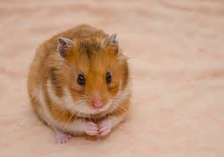
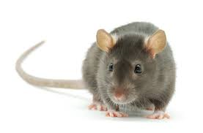
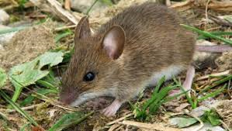
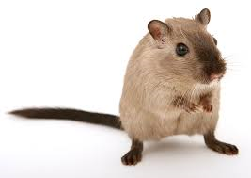
General Animal Handling Techniques: Rodents
How would you go about handling each of the below rodent species?
TASK: Write down a description in your own words.

Slide 10
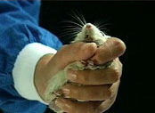
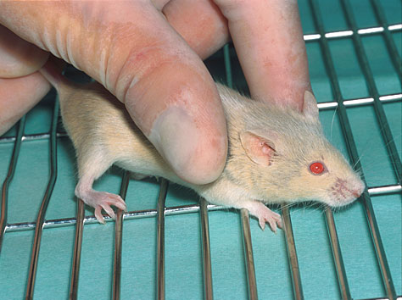
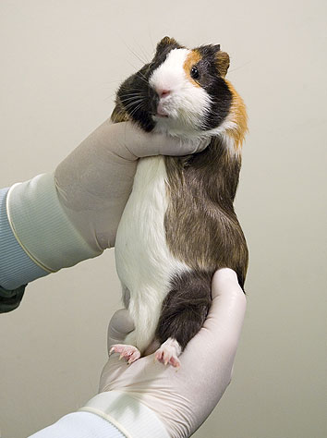
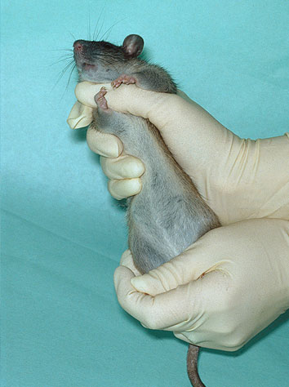
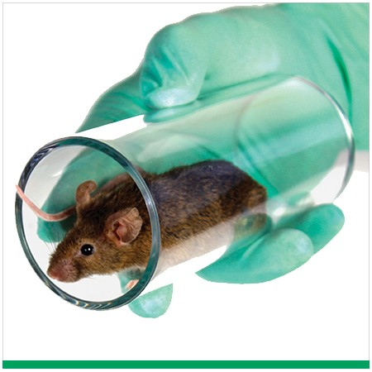
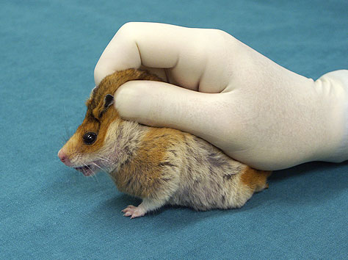
General Animal Handling Techniques: Rodents
Lots of examples to choose from.

Slide 11
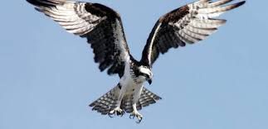
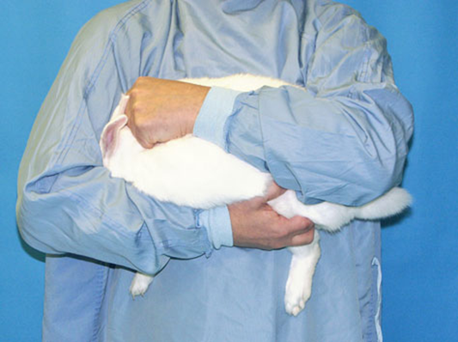
General Animal Handling Techniques: Rabbits
Rabbits can become stressed very easily as a result of poor handling and so it is really important to remain calm at all times.
Rabbits can be scooped up with both hands and into the arms if the rabbit is familiar with human interaction as it will remain still and can almost be cuddled against the body.
The other option would be to grasp the rabbit by the scruff (against the floor- NEVER PICKED UP LIKE THIS) and then the other hand can be used to pick up hindquarters.
DID YOU KNOW:
A lot of animal species can be calmed by their eyes being covered; effective with rabbits that are stressed.

Slide 12
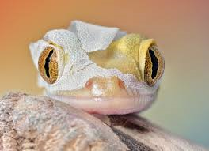
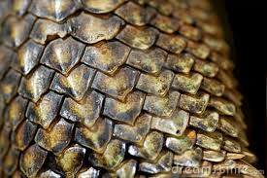
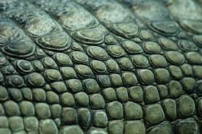
General Animal Handling Techniques: Reptiles
When working with reptiles one of the most important factors to consider is their shedding; some reptiles shed their entire skin at the same time, others in sections and some scale by scale.
If handling an animal which is just about to/has started to shed it is important to be very careful and only handle if needed; the shed can be pulled off and they can be a little more aggressive than normal (eyes are often the last part of the body to shed) due to discomfort.
Reptile scales lie on top of each other; what are the consequences for handling?

Slide 13
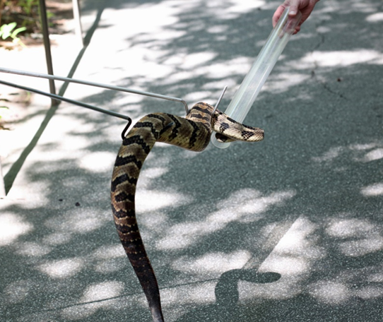
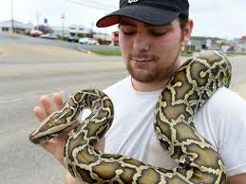
General Animal Handling Techniques: Snakes
When handling snakes it is important to remember that they use muscles all along their body to allow them to feel secure; if they feel insecure they will grip tighter onto an object (therefore they can wrap themselves around hands and arms quickly if they need to).
DID YOU KNOW:
A snakes’ natural approach to prey can indicate potential methods for handling them; if they are a species which strikes then they should be held away from the face. If they constrict they should never be placed around the neck (sash is an optional approach to this with some snakes).

Slide 14
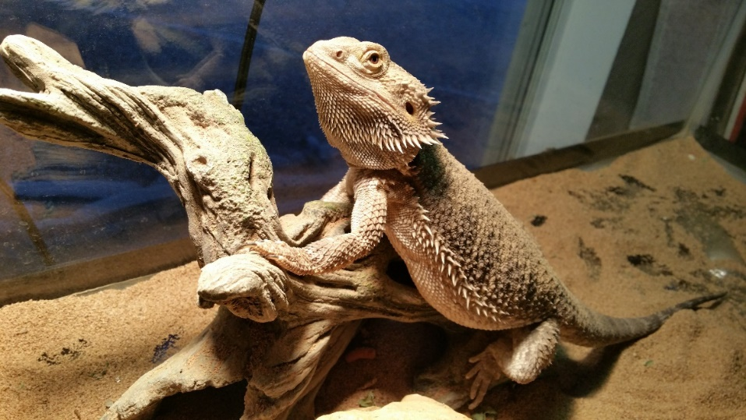
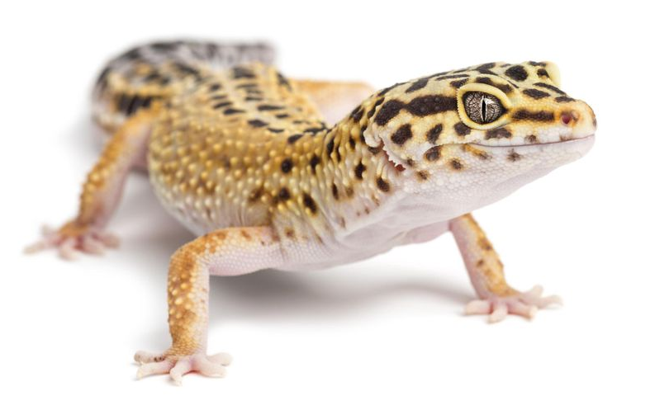
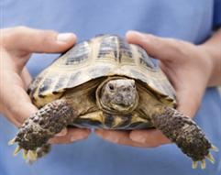
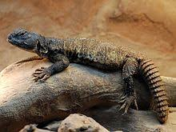
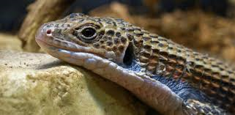
General Animal Handling Techniques: Lizards
Do you need to wear gloves?
Considerations with the below species?
Task: Research what you have to think about before handling a lizard.
Natural Behaviour?

Slide 15
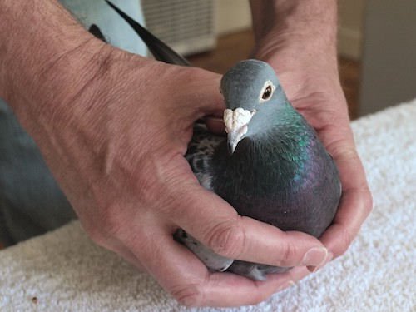
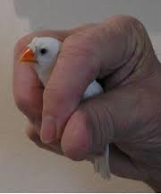
General Animal Handling Techniques: Birds
When handling birds, you need to be fairly quick (not enough to completely panic them but enough to mean that you can get a grip on them before they start flapping (as they can get hurt easily), the best approach is the “W” technique as you have control and support.
Tiny birds

Slide 16
General Animal Handling Techniques: Invertebrates
Invertebrates have an exoskeleton which supports their body from the outside rather than the inside (seen within the skeletal system in vertebrates) and many have different defence mechanisms…

Slide 17
General Animal Handling Techniques: Undomesticated/Wild Animals
Domestication has taken place over more than 10,000 years, so it is no surprise that some animal species react differently around us; some are content with interactions whilst others will go into flight/fight mode when in close contact.
You are not advised to handle wild animals due to their unpredictable nature and the chance of harm occurring (these animals retain their wild traits which protect them in the wild environment); although specific items can be used to assist any required handling.

Slide 18
General Animal Handling Techniques: Life Stage
Although the information we have looked at so far covers a wide range of species, you must always remember that each animal and each individual situation is slightly different, there is no “one size fits all” rule when it comes to handling animals.
Influences of Life Stage?
Influences of Health Status?
Influences of Handler?

Slide 19
Stress in Animals
Reducing stress? Why?
Stress can be defined as “a state of mental or emotional strain or tension which results from adverse or demanding circumstances”, it is something which can occur during the handling and restraint of an animal species (especially if the animal is injured).
Stress can affect different animals/individuals differently and often an unexpected reaction can be down to increased stress levels… here are some example below.

