Slide 1
Interesting Agriculture Facts

Slide 2
The world’s population is due to increase by almost 40% to 9.7 billion.
The changes in the agricultural sector and meeting global food challenges is more important than ever

Slide 3
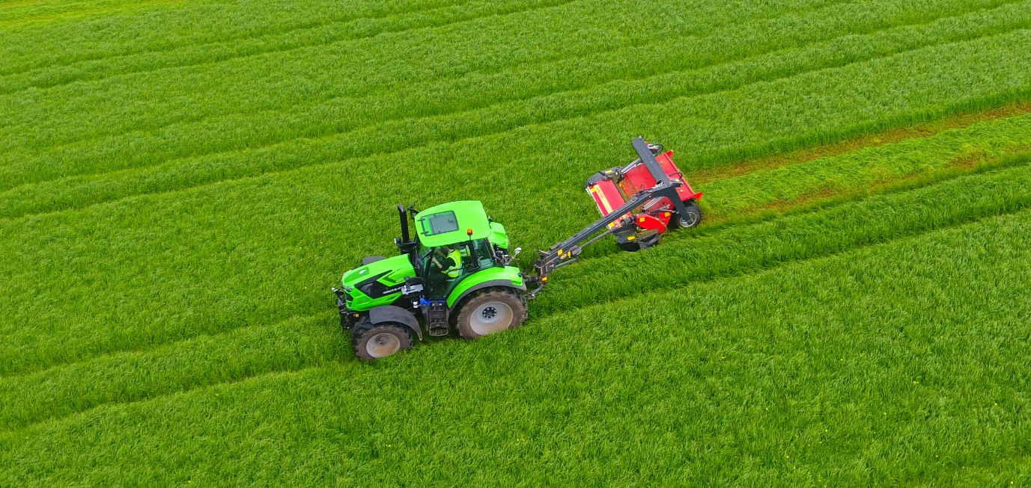
57%
of all the land in the UK is used for agriculture.
5.4%
of UK land is used to grow crops.

Slide 4
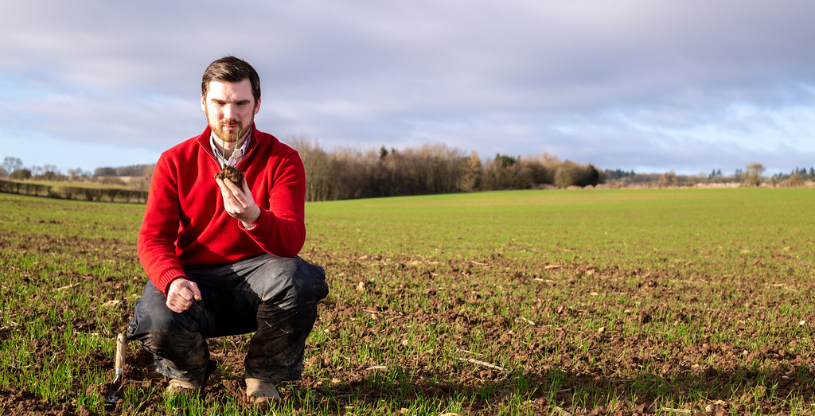

Slide 5
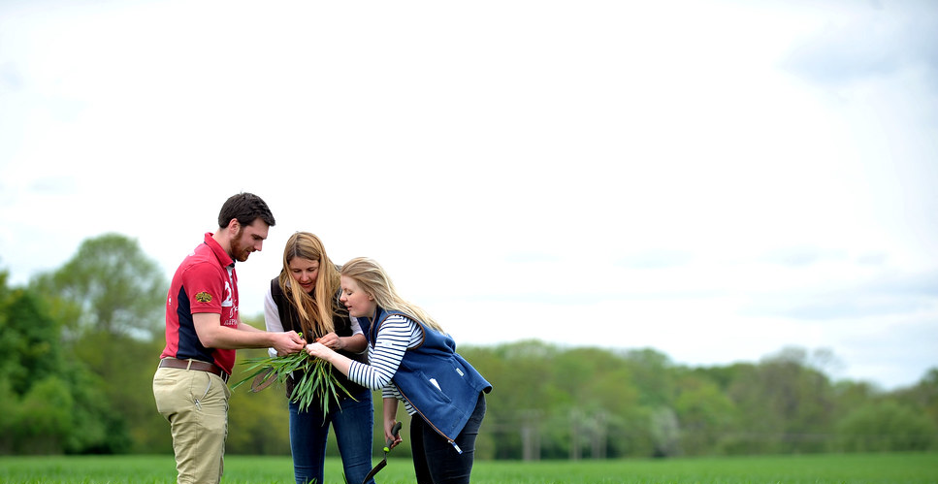
For every £1 invested in farm support….
Farming delivers £7.40 back to the economy

Slide 6
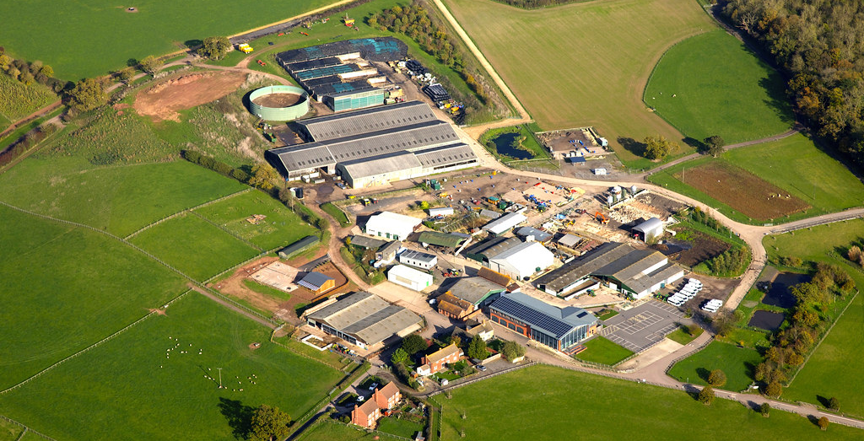
There are
280,000
farms in the UK and East Anglia is the top
crop-producing region.

Slide 7
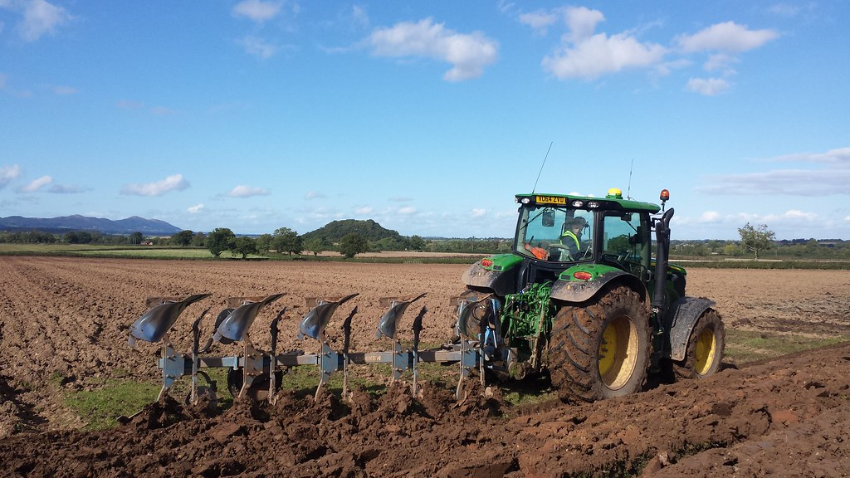
A large tractor can do in a day what used to take
100 people a week

Slide 8
Our new £2million Agri-Tech Centre helps the community gain experience of the latest smart farming technologies and have opportunities to collaborate on real-world projects to improve productivity and profitability.
The UK agri-tech sector contributes
£14.3 billion
to the UK economy

Slide 9
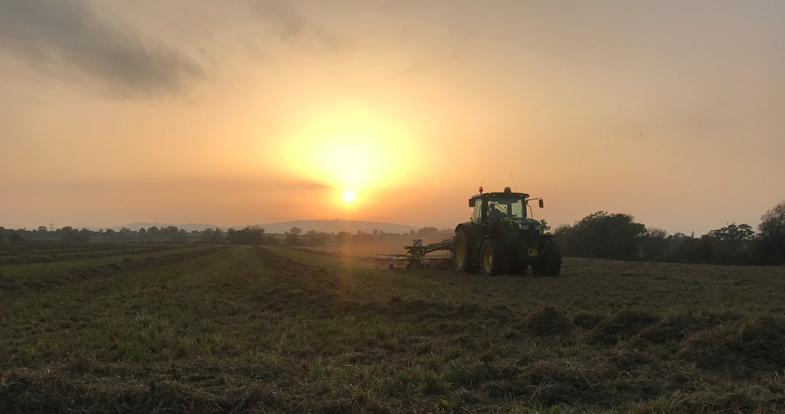
The iconic British countryside, which farmers manage, generates over £21 billion
in tourism income each year

Slide 10
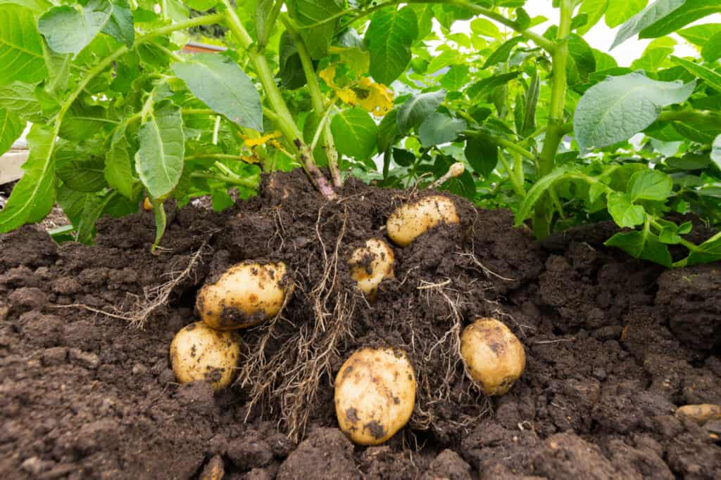
5.5 million
Tonnes of potatoes are produced in the UK each year
...Thats enough to make around
27.5 billion
packets of crisps!

Slide 11
The UK produces
7.8 million
tonnes of wheat for bread making annually, and the average person buys…
43 loaves per year!

Slide 12
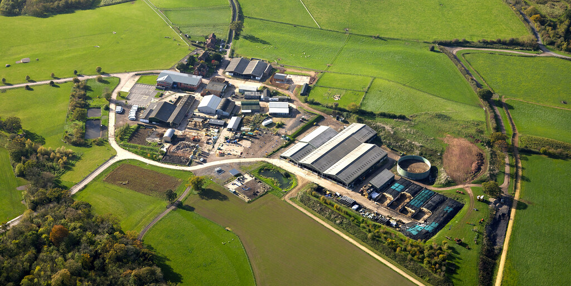
60%
of food eaten in the UK is grown in Britain
…and 77%
of shoppers agree its important to support British farmers.

Slide 13
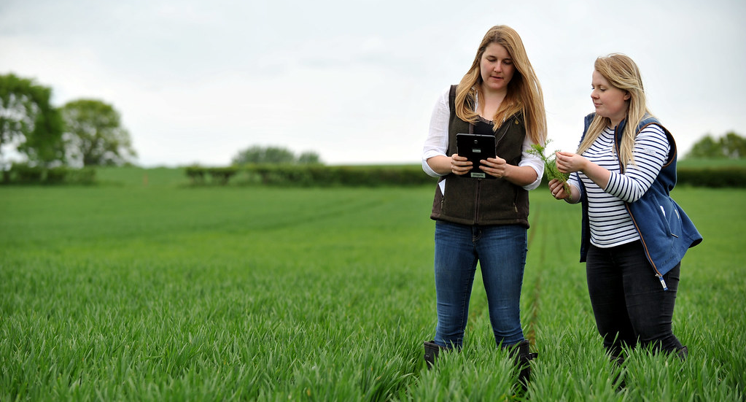
If the land used for crop production was a perfect square, it would take you just over
22 days
to walk the perimeter without any breaks!

