Slide 1
Thermal Imaging And Its Use In Animal Science
Hartpury University Outreach Team

Slide 2
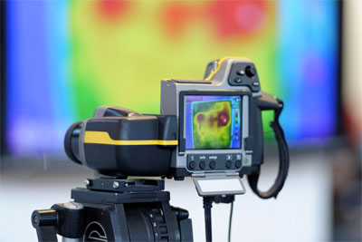
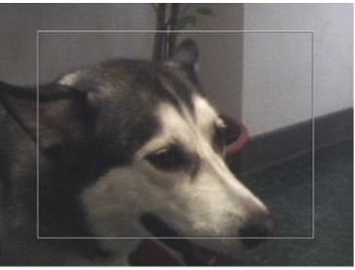
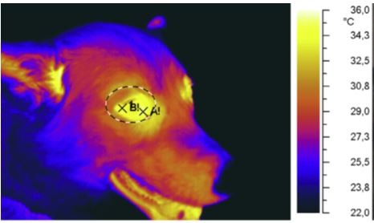
What is Thermal Imaging or Thermography?
Thermal imaging cameras effectively translate heat - that is, thermal energy - into visible light to analyse objects and surroundings.
Any object with a temperature above absolute zero will emit radiant energy.
Thermography is a name for a type of photography which is based on infrared wavelengths (as opposed to visible wavelengths).
Conventional photography relies on reflected energy from a light source, which is visible to our eyes. In contrast, thermal imaging relies on radiated energy in the infrared (IR) spectrum which is invisible to our eyes.
All objects emit radiation energy within the IR spectrum. This IR radiation varies dependent on the temperature of that object’s surface.
Thermal imaging cameras are used as a non-contact measurement of an animals temperature.

Slide 3
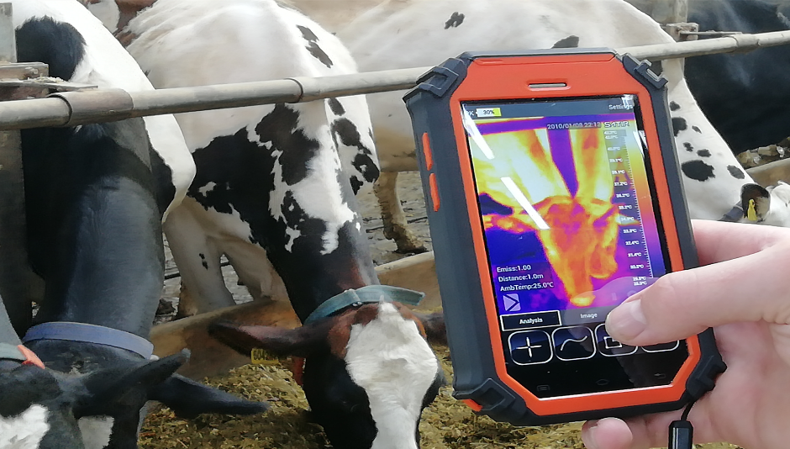

Thermography in Animal and Equine Science
Body surface temperature can be affected by both internal and external factors.
Using thermal imaging abnormal hot or cold areas can be identified. These can relate to a number of conditions in animals.
  Fever
  Source of pain
  Inflammation
  Nerve injuries
  Vascular disorders
  Neurological disorders
  Physiological stress
  Injury or trauma
  Musculoskeletal overloads
Thermal imaging cameras are easy to transport and are low stress for the animal.
Notes:
Inflammation (equine - “hot spots” in horses – inflammatory lesions, early detection)
Nerve injuries (equine - decrease in body surface temperature)

Slide 4
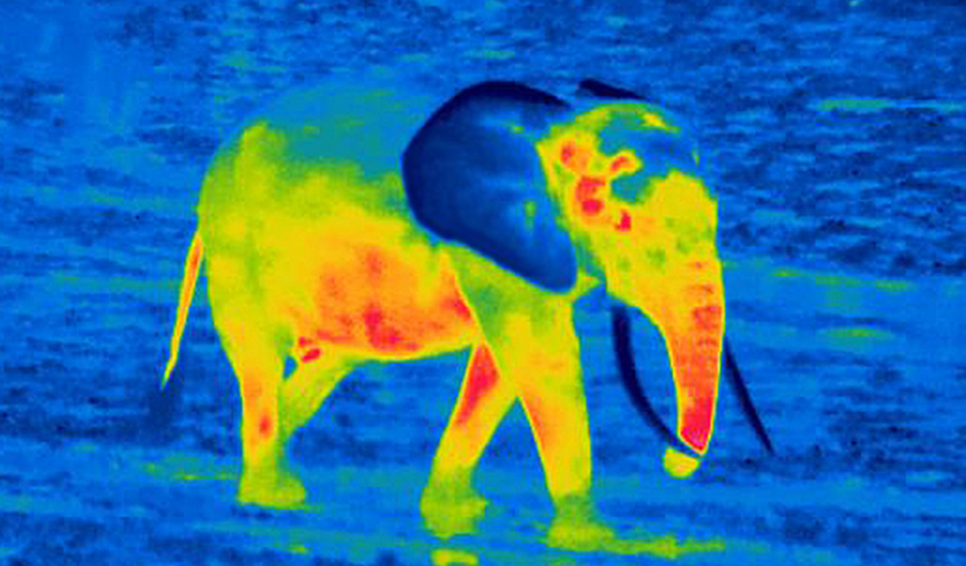
Guess the Animal
A
These animals remain cool using their large ears, where huge volumes of blood are circulated close to the surface of the skin enable dissipation of heat.
Different species sometimes have smaller ears and have been shown to lose heat through their trunks overnight, rather than their ears. and are known to cool off overnight and begin the day at a lower temperature.
Answers at the end!

Slide 5
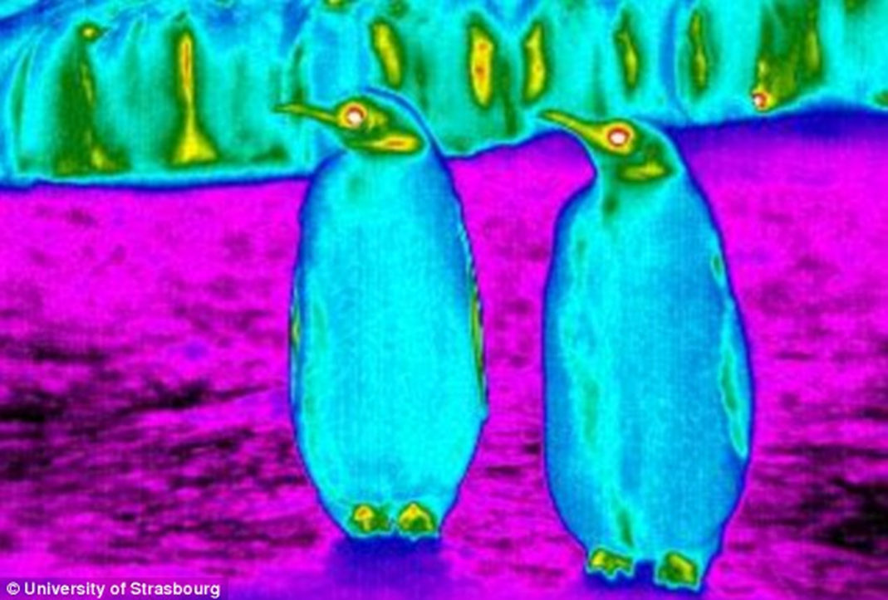
Guess the Animal
B
A study in Antarctica showed that this animal can actually have a colder surface temperature than the surrounding air (by 4 to 6℃).
This was due to extreme radioactive cooling where the animal loses heat to the clear sky in which heat escapes rapidly from the atmosphere.
Their feathers also have a specialised structure that acts as an insulator to keep the dangerously low temperatures away from their skin.

Slide 6
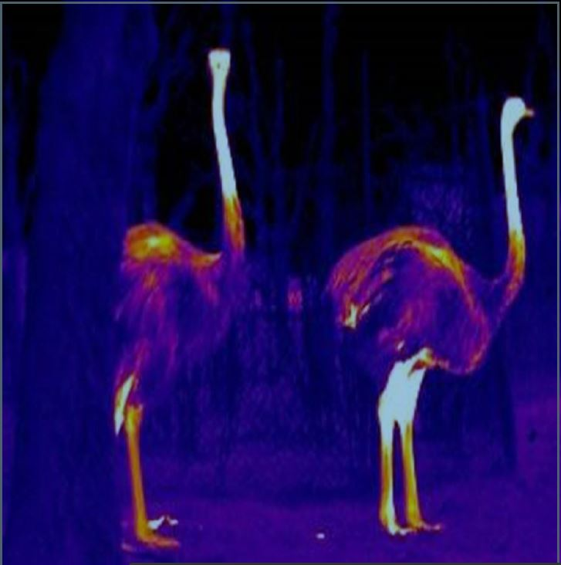
Guess the Animal
C
This animal is native to Africa.
They need to be able to vent heat during the day and stay warm at night. At night, when they settle down for sleep, they tuck their legs underneath, helping to preserve warmth.
During hot days, their feathers reflect heat away while running around helps circulate cooler air over their skin.
Answers at the end!

Slide 7
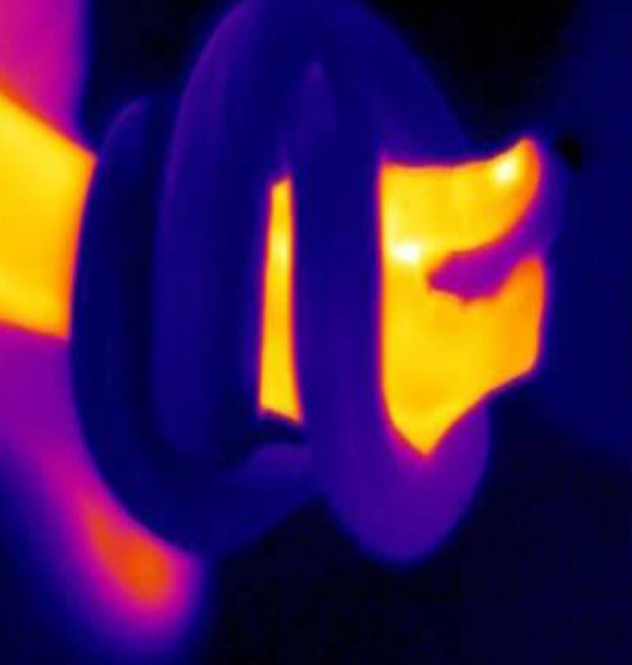
Guess the Animal
D
These animals are cold-blooded reptiles that do not show up on thermal imaging (the yellow is a human arm!).
Despite the existence of thousands of different species, they are all ectotherms.
This means they use external heat sources to regulate internal temperature and so have evolved to retain heat from the environment.
Answers at the end!

Slide 8
Guess the Animal… Answers
A = Elephant
African Elephants remain cool by using their ears. Asian Elephants use their trunks.
B = Emperor Penguins
C = Ostrich
D = Snake

